Slide 1
Category review: Chips
June 2020
Retail Analytics

Slide 2
Notes:
To view Privacy video explaining how important data privacy is to Quantium, please click here: https://www.youtube.com/watch?v=Zq1QDAkoRzU
or here Q:\Company Reference\Brand & Design\Brand videos\Q Privacy.mp4
At Quantium, we believe that data is the behavioural footprint of humanity and that it has to be treated with the utmost care and responsibility.
Histories, attitudes, indeed lives are stored within it in ways that aren’t always apparent – and that’s what makes its potential so powerful.
To work with it responsibly, sensitively, we set ourselves the highest data privacy protection and governance standards.
We have spent 17 years perfecting privacy-by-design and secure-by-design principles. Central to this is not holding any personally identifiable information about people –
we neither receive it, and put the necessary protections in place to be unable to decipher it.
Every aspect of handling data is safeguarded: from its de-identification, to its encryption – data security is paramount and of the highest grade.
We pride ourselves on gaining the trust of iconic organisations around the world through years of securely working with their data,
and in turn the trust that builds with their stakeholders.

Slide 3
Executive summary
01
Chips Category Review
The sales number of chips transactions dramatically increase in the month of December before Christmas (except the day itself). So, these are the crucial times.
The three highest contributing segments to total sales are: 1. Budget - older families, 2. Mainstream - young singles/couples 3. Mainstream
Factor driving sales: Older Families have the highest average quantity per order, while Mainstream - young singles/couples and Mainstream – retirees have the highest population.
Mainstream young singles and couples are 28% more likely to purchase KETTLE chips compared to the rest of the population. Also 175-gram packets are most sold.
02
Trial Store Analysis
One Control store was selected for each trial store and the values of metrics were compared in trial and pre-trial period.
The results for trial stores 77 and 88 during the trial period show a significant difference in at least two of the three trial months but this is not the case for trial store 86.

Slide 4
01
Category

Slide 5
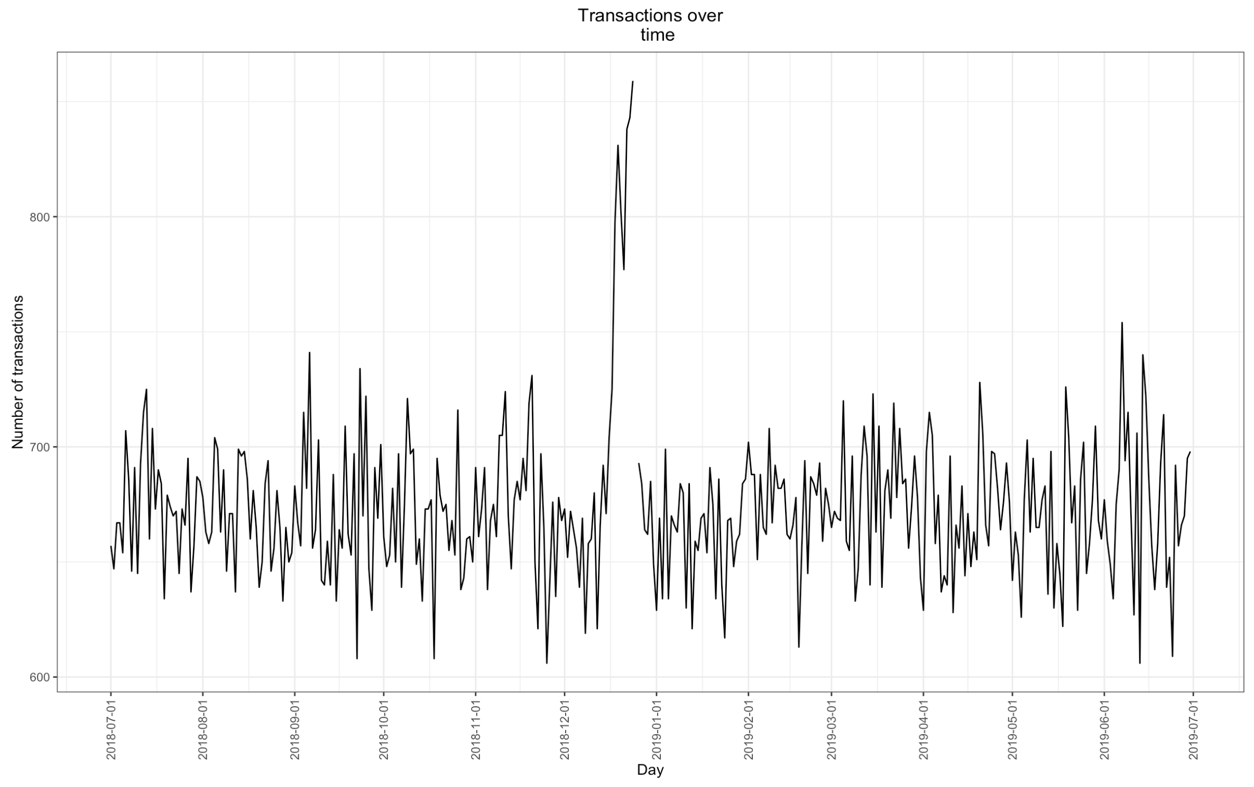
Sales Distribution
The number of Chips transitions has remained relatively consistent over the last 52 weeks; a notable increase occurred in the week leading up to Christmas

Slide 6
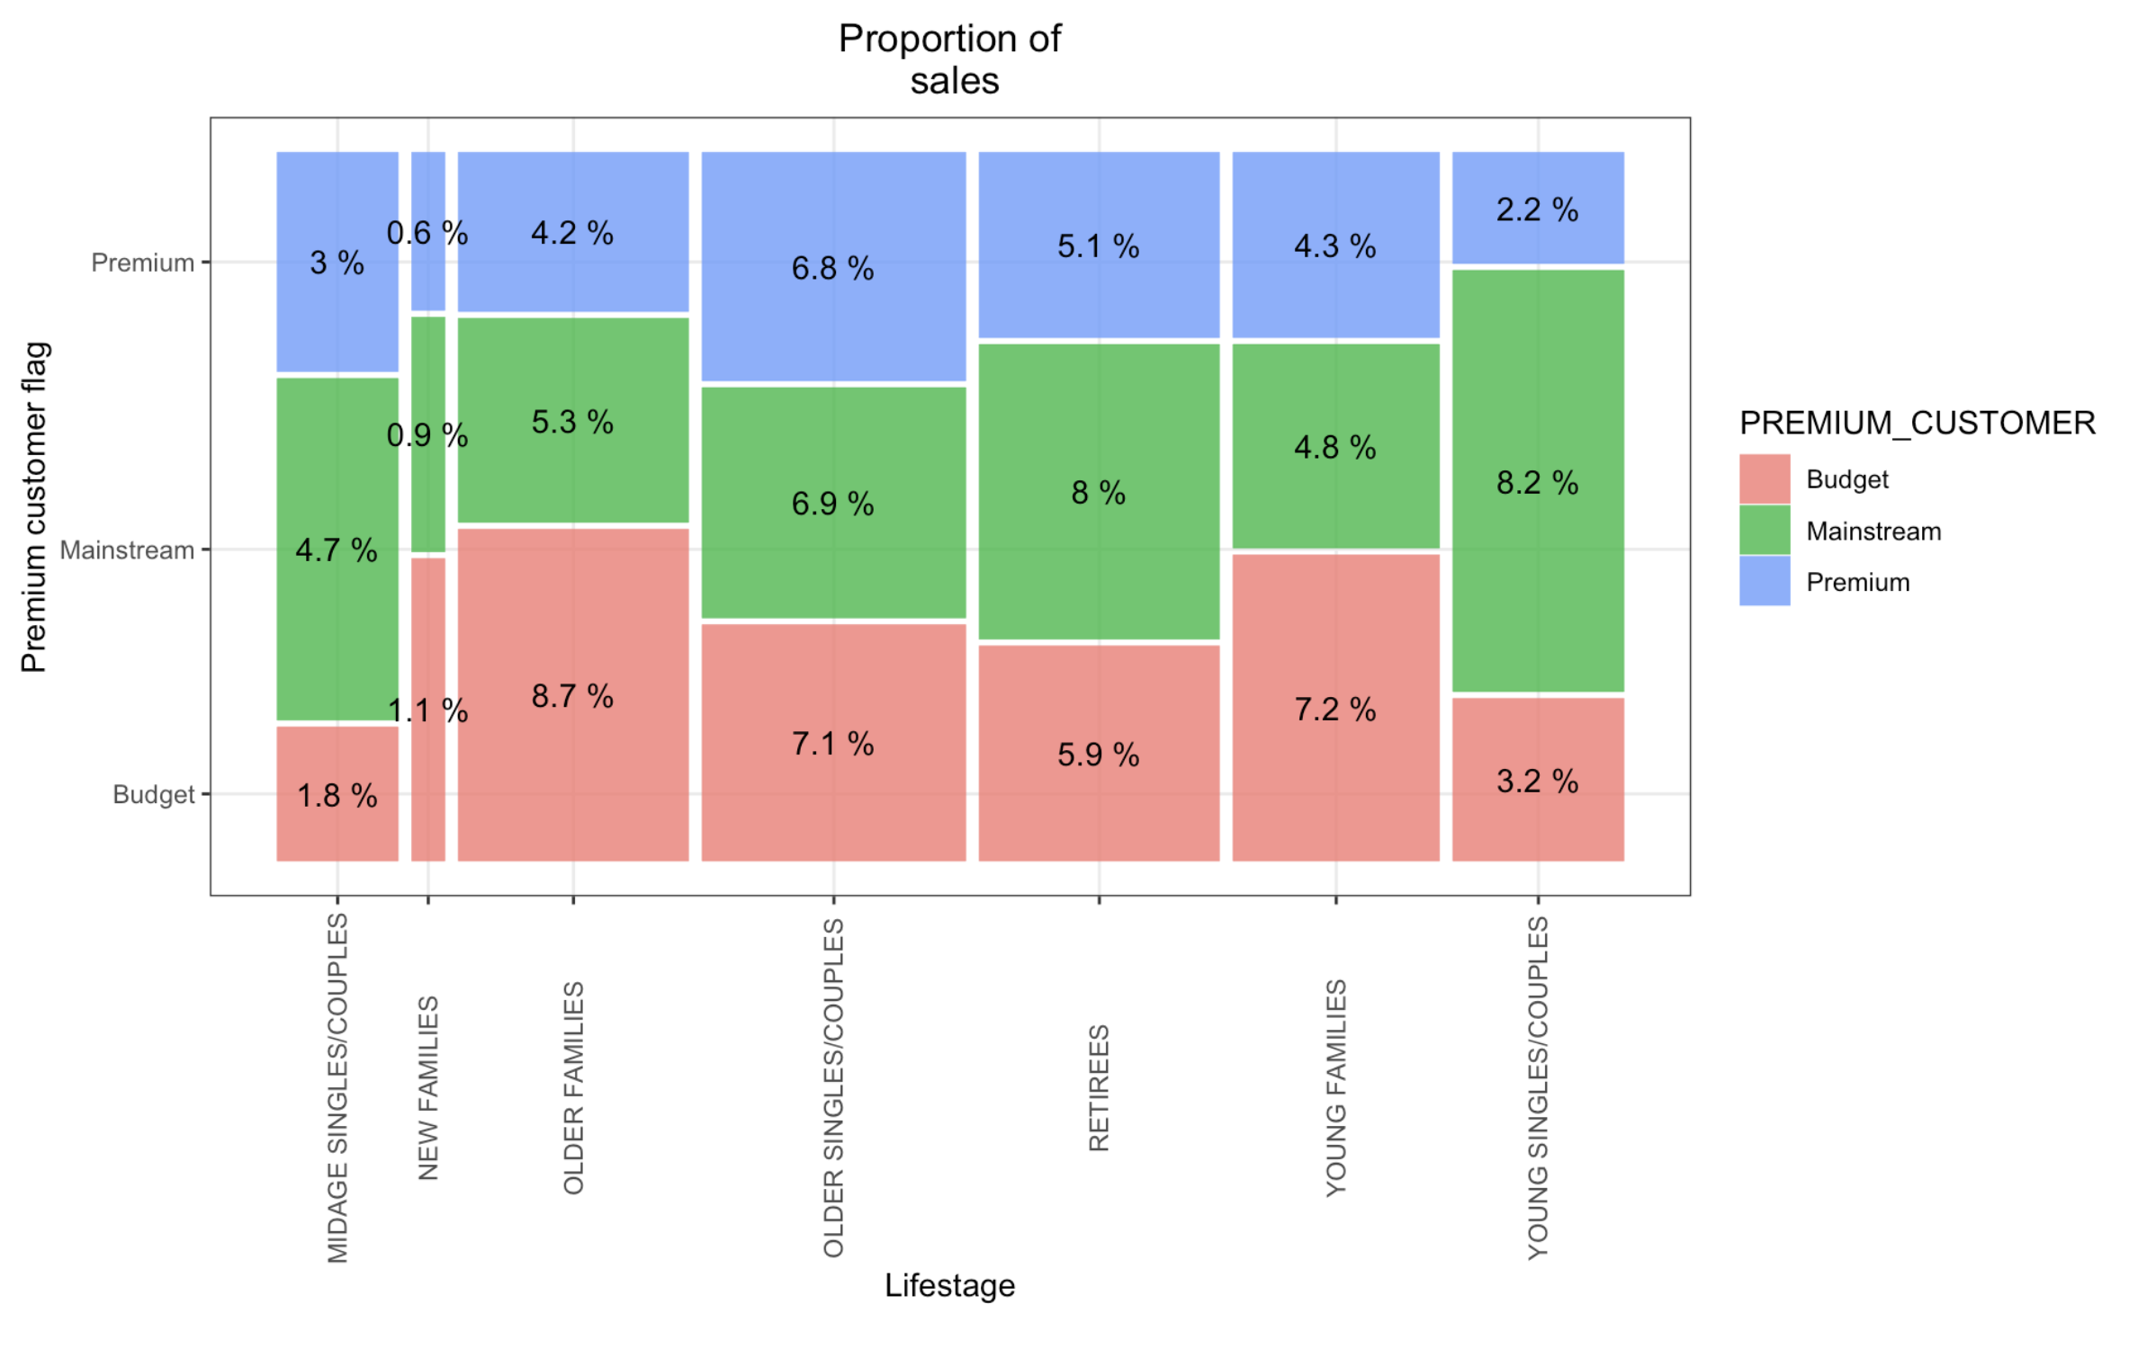
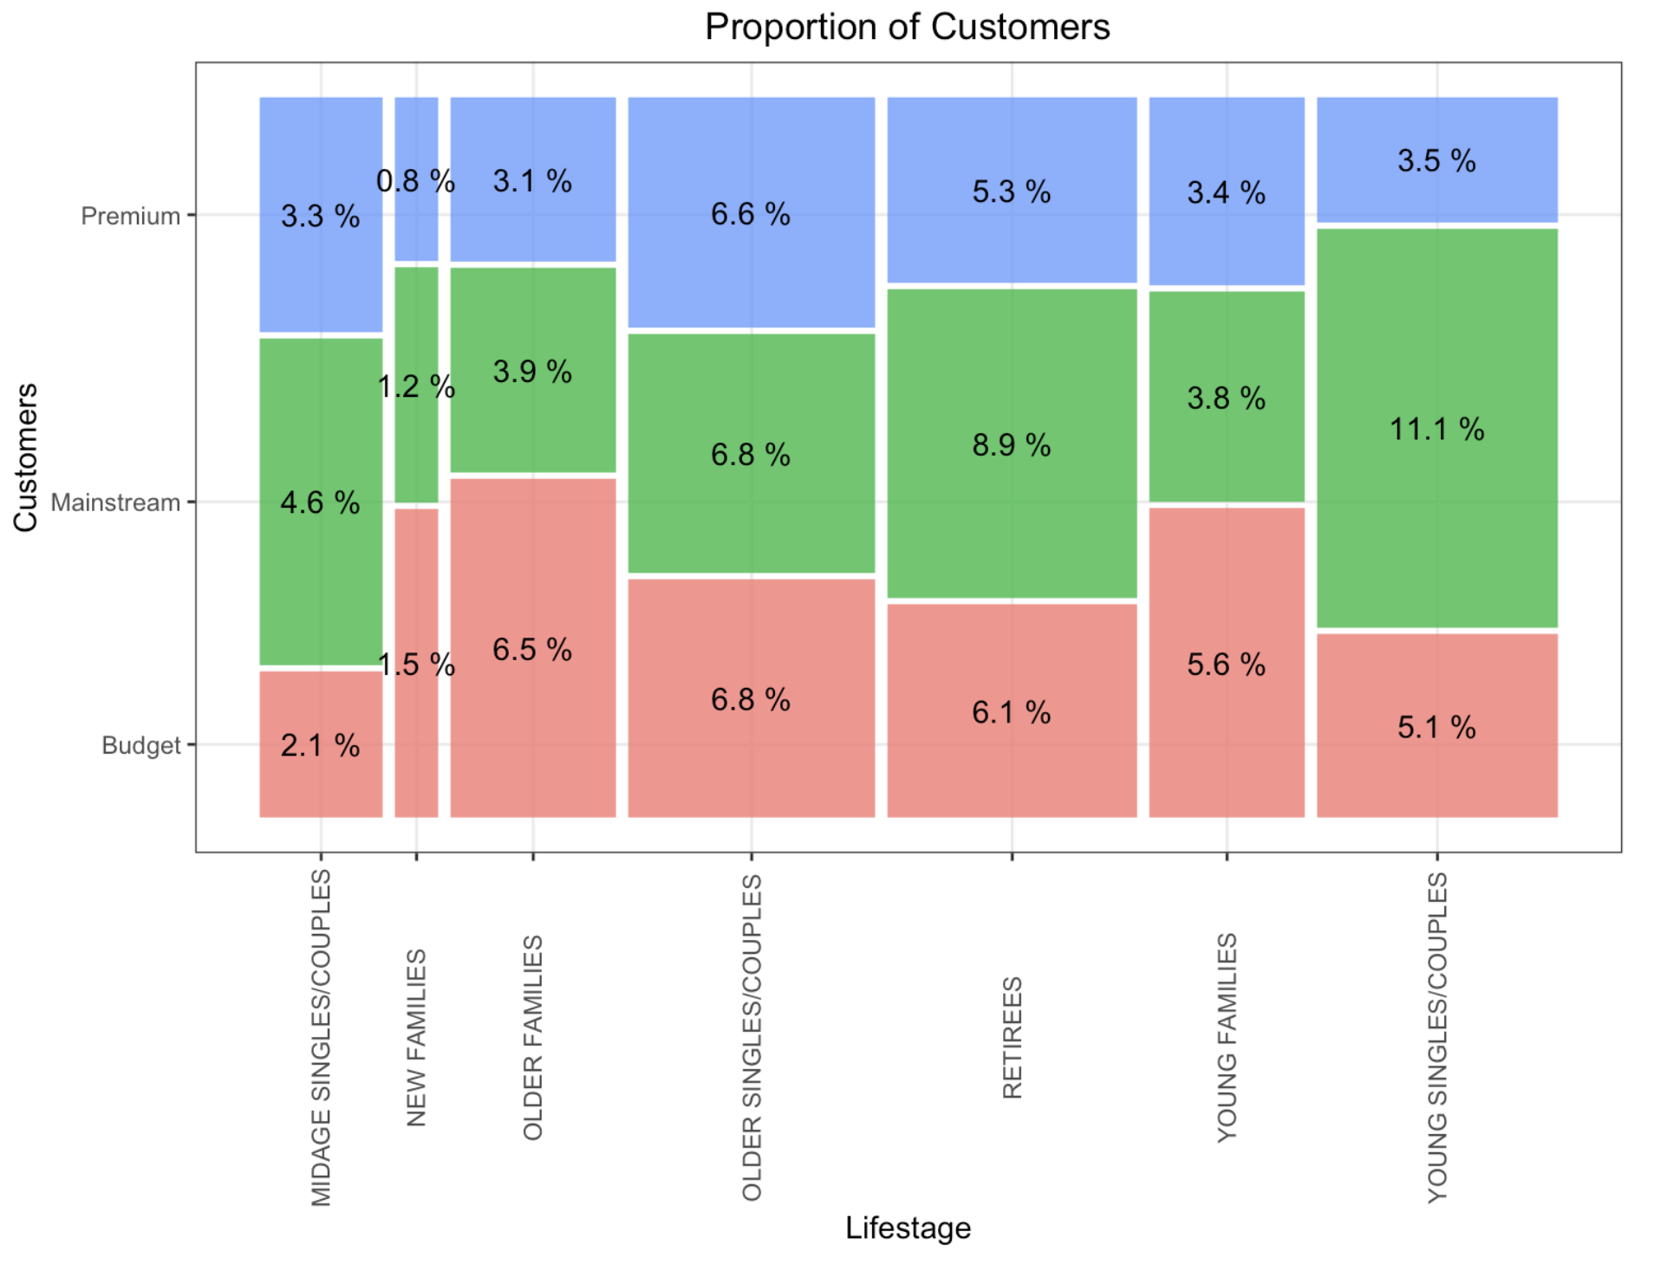
Proportion of Sales and Customer in each Segment
Sales are coming mainly from Budget - older families, Mainstream – young singles/couples, and Mainstream – retirees. Mainstream – young singles/couples have largest population

Slide 7
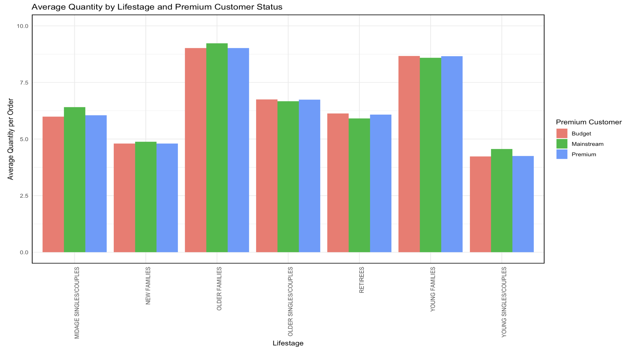
Editable (delete this)
Visualising the average order quantity by affluence and life stage
Older families and young families in general buy more chips per customer.

Slide 8
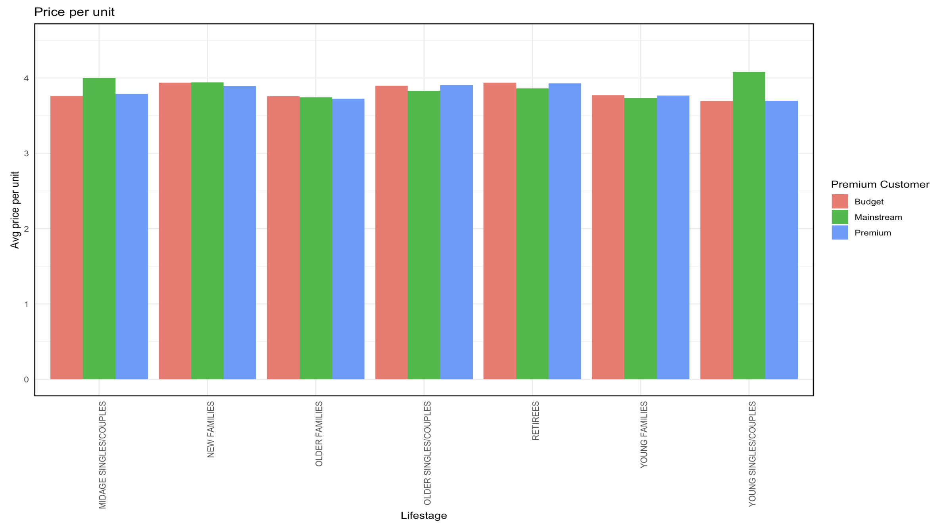
Visualising the average price per unit by affluence and life stage
Mainstream mid-age and young singles and couples are more willing to pay more per packet of chips compared to their budget and premium counterparts.

Slide 9
02
Trial store performance

Slide 10
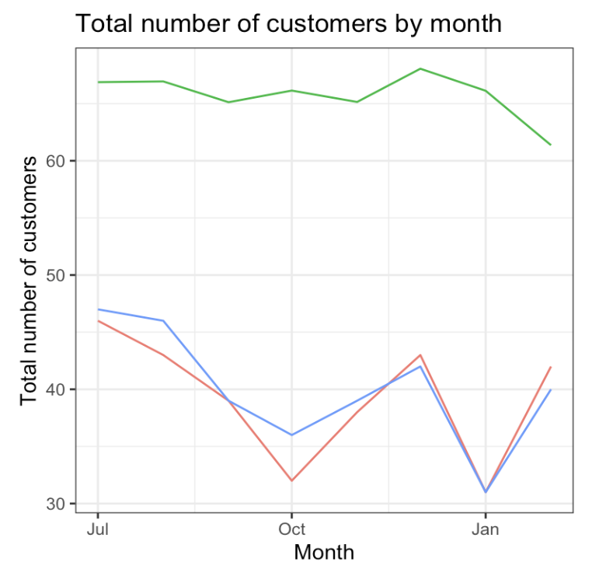
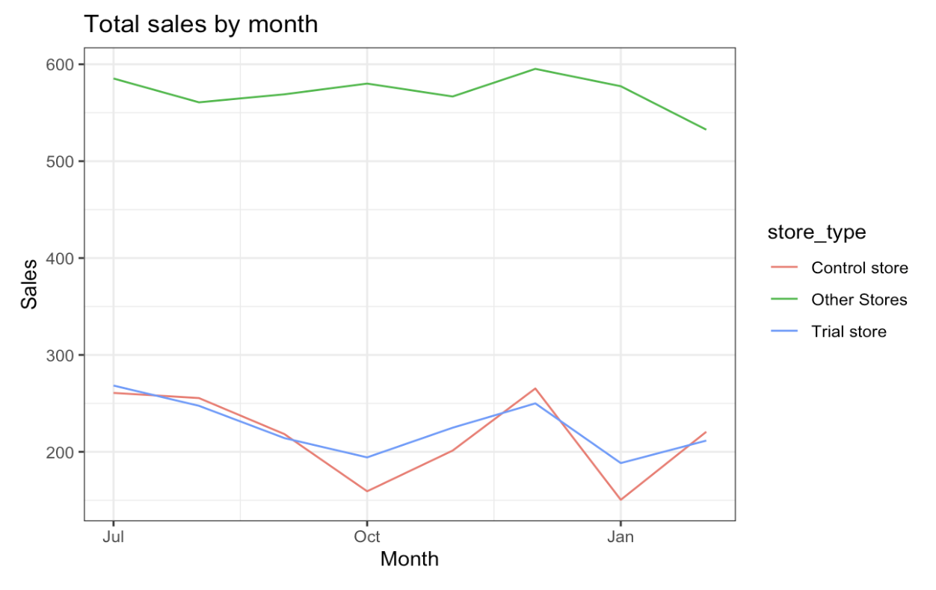
The control store is constructed to reflect performance of the trial store rather than the average of other stores. See e.g. stores 77(trial) and 233(control):

Slide 11
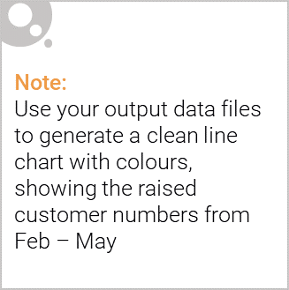
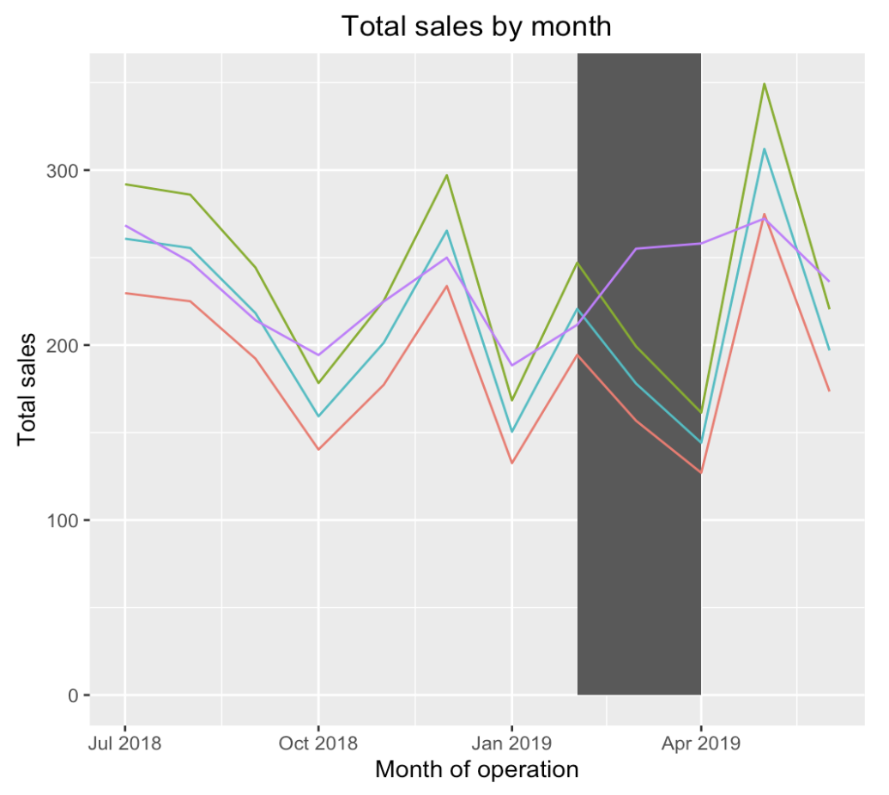
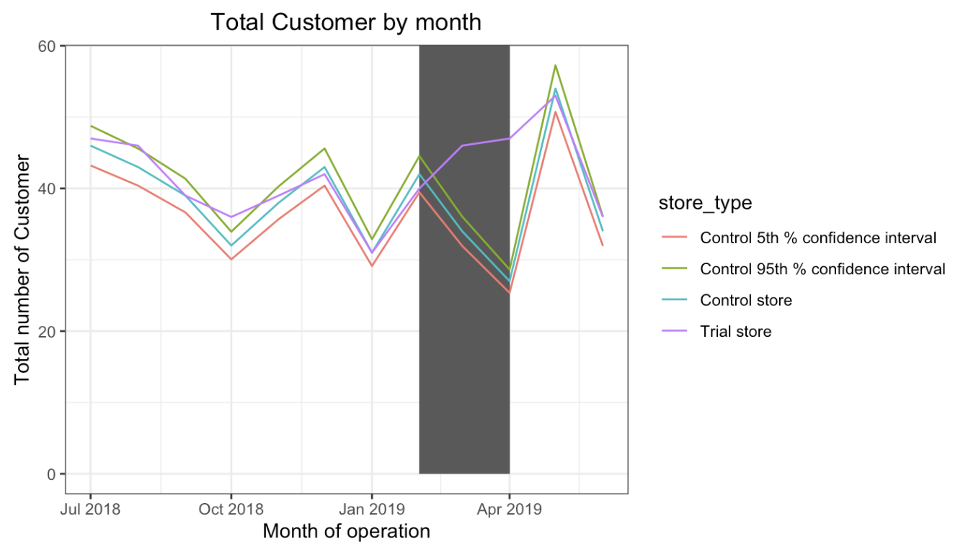
Trial store 77 and control store 233: trial success, with increases in sales and customer numbers.

Slide 12
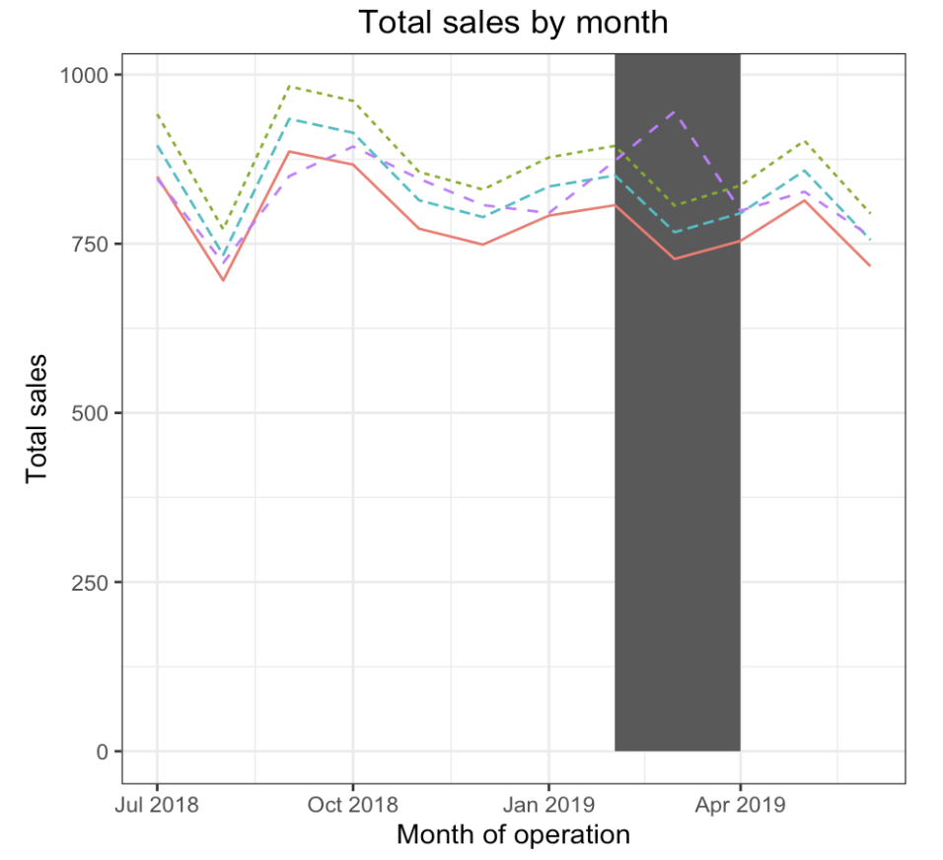
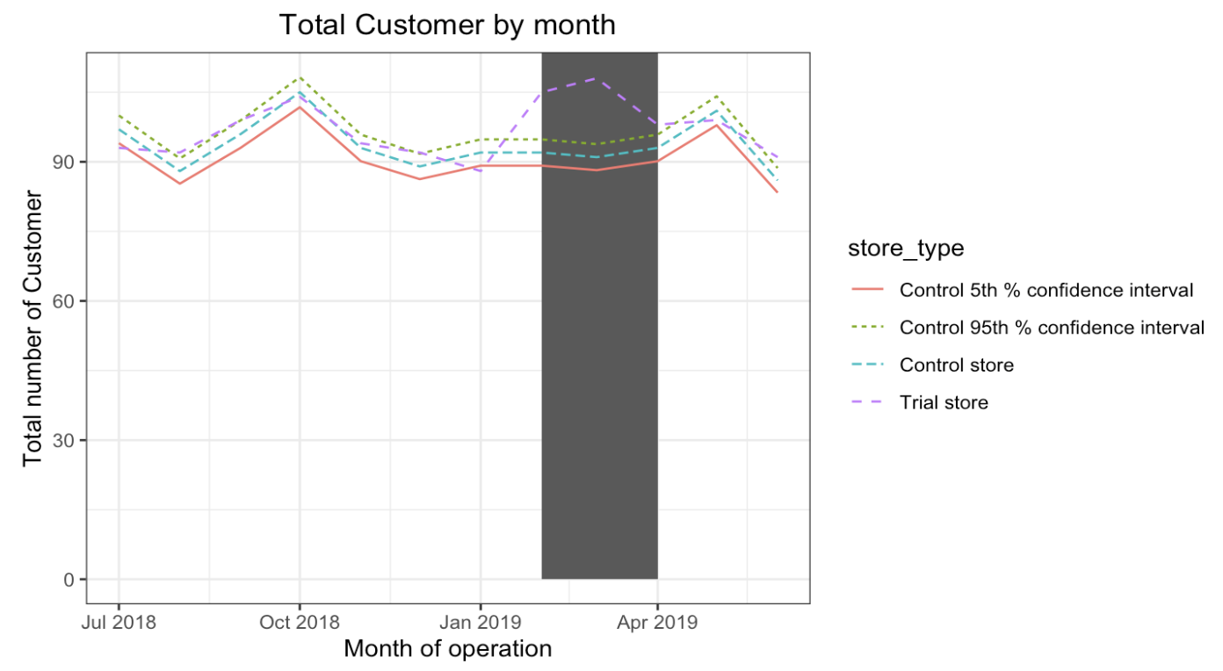
Trial store 86 and control store 155: trial success is modest, with increases customer numbers, and sales significantly different in one out of there months

Slide 13
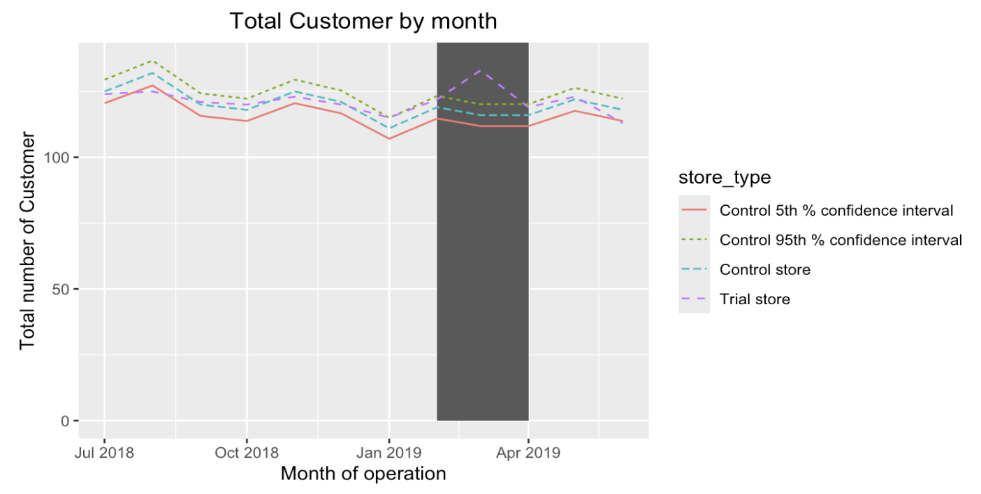
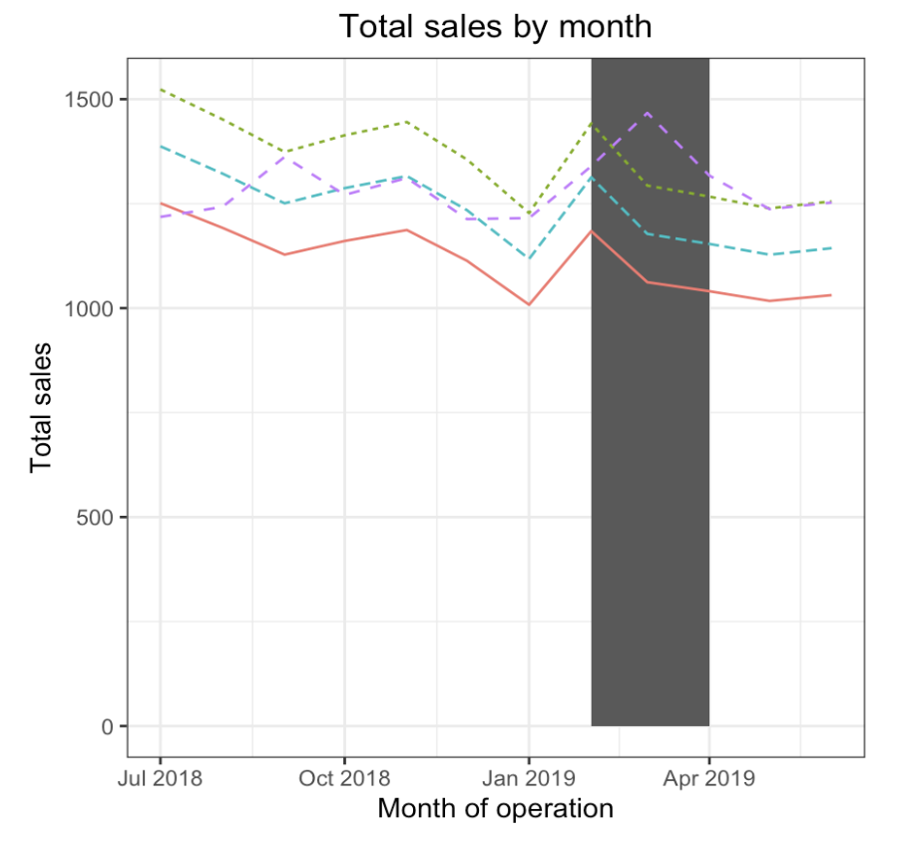
Trial store 88 and control store 237: trial success, with increases in sales.

Slide 14
Conclusion
We've found control stores 233, 155, 237 for trial stores 77, 86 and 88 respectively.
The results for trial stores 77 and 88 during the trial period show a significant difference in at least two of the three trial months but this is not the case for trial store 86.
We can check with the client if the implementation of the trial was different in trial store 86 but overall, the trial shows a significant increase in sales.
Recommendation
Stocks should be high in December before the Christmas
Kettle, Smiths, Doritos and Pringles should be kept in stocks as they are the most sold
Mainstream young singles/couples, retirees are the account for a great share of chips sale, so they need much attention.
Budget older families have the maximum contribution to sales.
Control stores 233, 155, 237 for trial stores 77, 86 and 88 respectively would be a good choice

